Slide 1
SOFTWARE PROJECT LAB -1
PRESENTED BY
JITESH SUREKA
ROLL: 1115

Slide 2
Project Name : IMAGE PROCESSING TOOLS Language Used : C, C++

Slide 3
PROJECT MOTIVATION
WANTED TO EXPLORE THE IMAGE MANUPULATION SIDE OF THE TECHNOLOGY FIELD
WANT TO WORK ON A BIGGER PROJECT WHICH WILL REQUIRE RIGOROUS WORK ON IMAGE MANUPULATION

Slide 4
PROJECT IDEA
Take Image as Input
It will consist of a menu containing a number of Image Processing Tools
Increment or decrement options will be given for each image modification tool
Output Image will be saved as a new file
Primarily, the project will focus on the following image processing tools
Smoothing, brightness control, Sharpening, Gray-Scaling , Edge Detection etc.

Slide 5

PROGRESS SO FAR
TAKE PATH OF .BMP FORMAT IMAGE AS INPUT
READ THE HEADER AND PIXEL DATA OF THE IMAGE
STORE THE DATA IN VARIABLES AND ARRAYS
reducing brightness of image
WRITE THE HEADER IN THE OUTPUT FILE
WRITE THE PROCESSED IMAGE PIXELS IN THE OUTPUT FILE

Slide 6
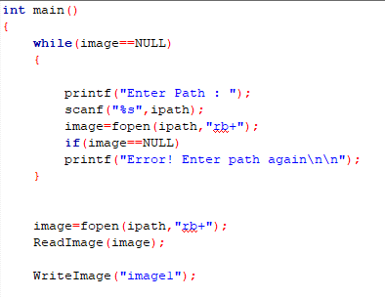
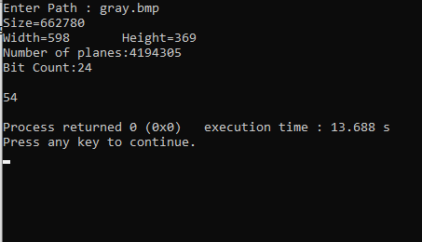
TAKING PATH AS INPUT

Slide 7
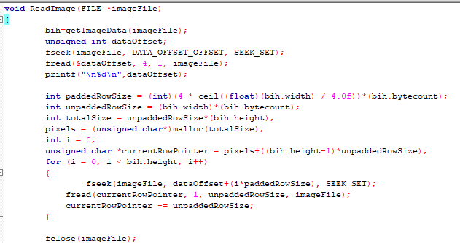

READING AN IMAGE

Slide 8
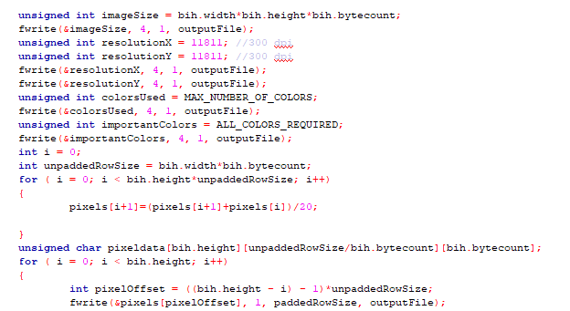

WRITING THE PROCESSED IMAGE

Slide 9
STUDIED SO FAR
READING AND WRITING AN IMAGE FILE
STRUCTURE OF A .BMP FORMAT IMAGE FILE
WAYS TO READ THE HEADER INFO FOR .BMP IMAGE FILE
WRITING THE HEADERS IN OUTPUT FILE
MODIFYING THE PIXEL DATA

Slide 10
FUTURE IMPLEMENTATION PLANS
ADDING FURTHER FEATURES FOR IMAGE PROCESSING INCLUDING EDGE DETECTION, GRAY-SCALING AND SMOOTHING
ADDING USER MENU TO THE PROGRAM

Slide 11
REFERENCE LINKS
https://www.google.com/url?sa=i&url=https%3A%2F%2Fwww.justinmind.com%2Fblog%2F10-inspiring-progress-bars-that-delight-users%2F&psig=AOvVaw3lVbNc_-Pl0g2vKqQlKWJa&ust=1584001485547000&source=images&cd=vfe&ved=0CAMQjB
https://en.wikipedia.org/wiki/BMP_file_format
http://homepages.inf.ed.ac.uk/rbf/BOOKS/PHILLIPS/cips2ed.pdf

